Slide 1
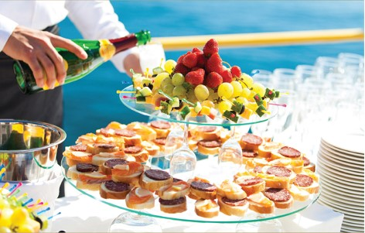
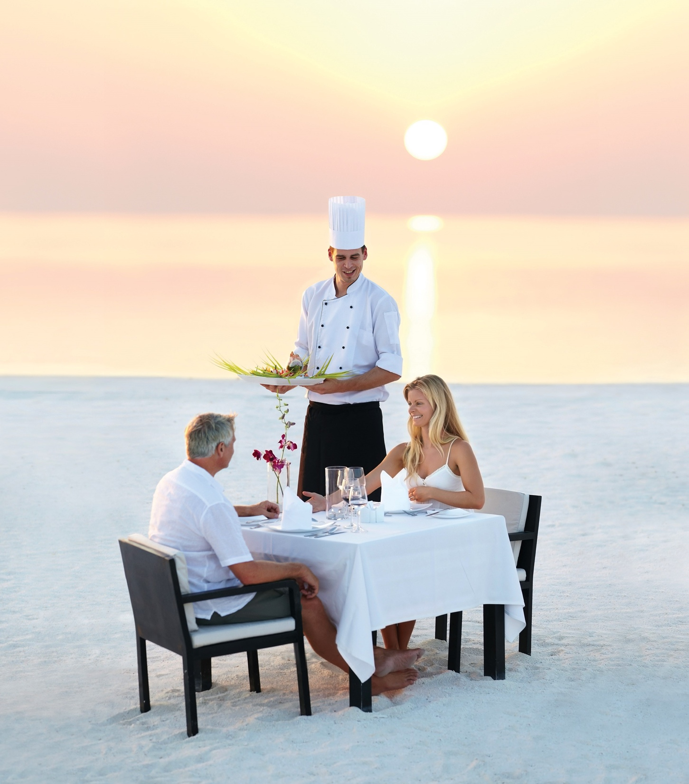

Chapter 3
Understanding the consumer
Introduction to customer service
© Hudson & Hudson. Customer Service for Hospitality & Tourism 3rd edn

Slide 2

Topics covered
  Customer expectations
  The impact of delighting and surprising customers
  The influences on the customer experience
  Delivering a consistent experience
  The role of emotions in customer service
  Cross-cultural differences in service delivery
  Global trends in consumer behavior

Slide 3
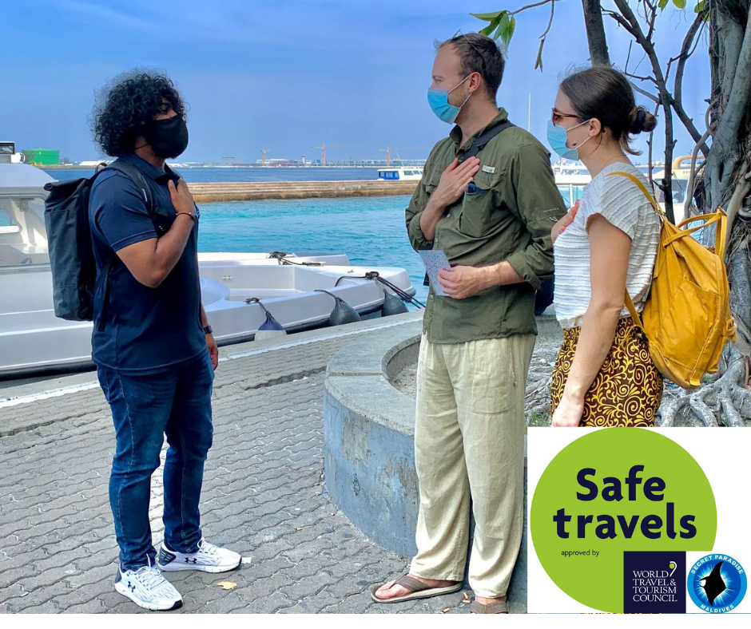
‘At Your Service’ Spotlight:
The Maldives – pivoting in response to the pandemic
In 2019, Maldives welcomed 1.7 million inbound arrivals and tourism revenues accounted for 56.6% of the Maldives’ GDP.
The pandemic therefore had a devastating effect on the economy.
At the beginning of the tourism shutdown, 90% of resorts sent their workers home without pay or cut their salaries by 15-20%.
The Maldives Marketing & Public Relations Corporation (MMPRC), which promotes travel to the Maldives, continued to advertise
Phased opening - hotels and resorts had to make operational changes to comply with new standards and to reassure potential guests.

Slide 4
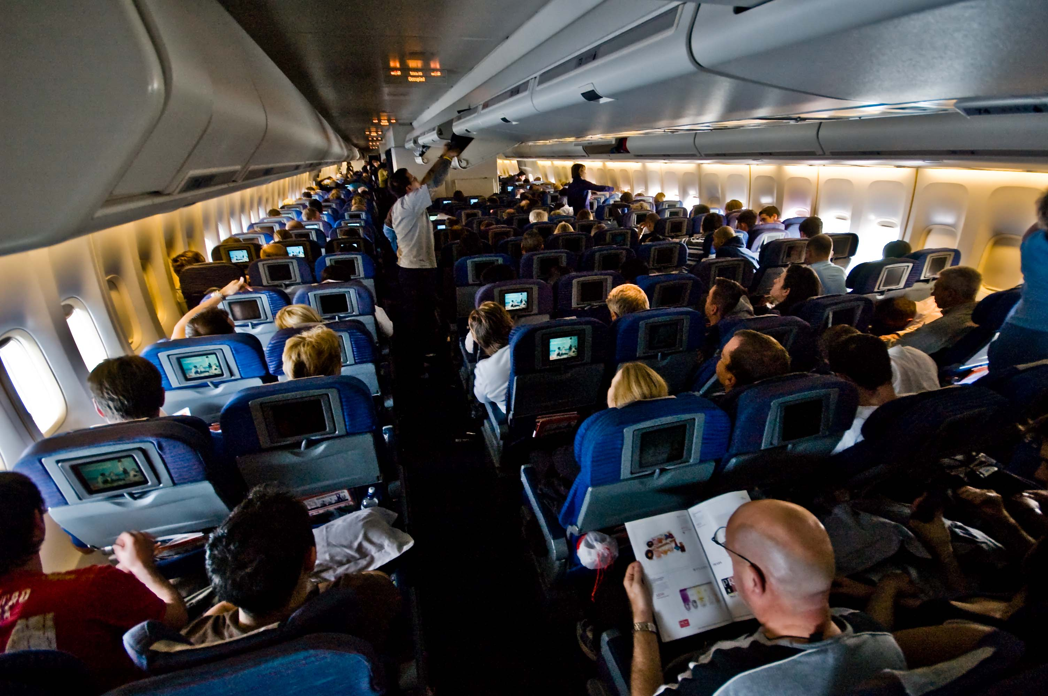
Customer expectations
Customer expectations
  May vary within a sector (e.g EasyJet vs. Singapore Airlines)
  May change over time
  Seem to have been heightened by the COVID-19 pandemic
Three levels of expected service
  Desired
  Adequate
  Predicted
The Zone of Tolerance falls between desired and adequate service
Notes:
Customer expectations
Customer expectations
May vary within a sector (e.g EasyJet vs. Singapore Airlines)
May change over time
Three levels of expected service
Desired
Adequate
Predicted
The Zone of Tolerance falls between desired and adequate service

Slide 5
Factors influencing customer expectations of service

Slide 6
Customer experience
Physical environment
  e.g. Ambience, multisensory impact, space and function, signs and symbols
Human interaction
e.g. Service consumption in the presence of staff
and other customers
Personal characteristics
e.g. Cultural differences
Trip-related factors
e.g. Social and intellectual needs versus physiological needs

Slide 7
Delighting and surprising customers
Customer delight
  Positive affect resulting from unexpected pleasure
  Effective for connecting emotionally with consumers
  Exceeds customers’ expectations to a surprising degree
  Surprising customers can build loyalty (e.g. Hyatt Hotels & Resorts)

Slide 8
Customer experience
Physical environment
  e.g. Ambience, multisensory impact, space and function, signs and symbols
Human interaction
e.g. Service consumption in the presence of staff
and other customers
Personal characteristics
e.g. Cultural differences
Trip-related factors
e.g. Social and intellectual needs versus physiological needs

Slide 9
Blueprint for Overnight Hotel Stay

Slide 10
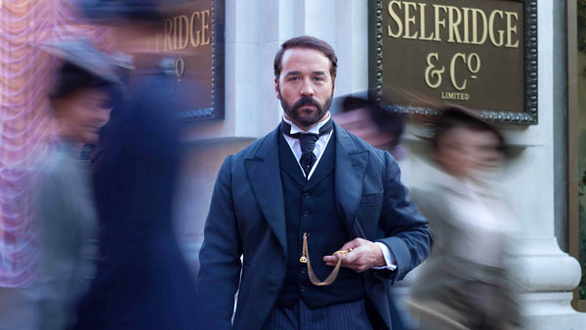
Consistency in customer experience
Delivering a consistent and distinctive customer experience is critical
Retail pioneer Gordon Selfridge encouraged staff to delight customers the ‘Selfridges Way’
He coined the phrase ‘the customer is always right’

Slide 11
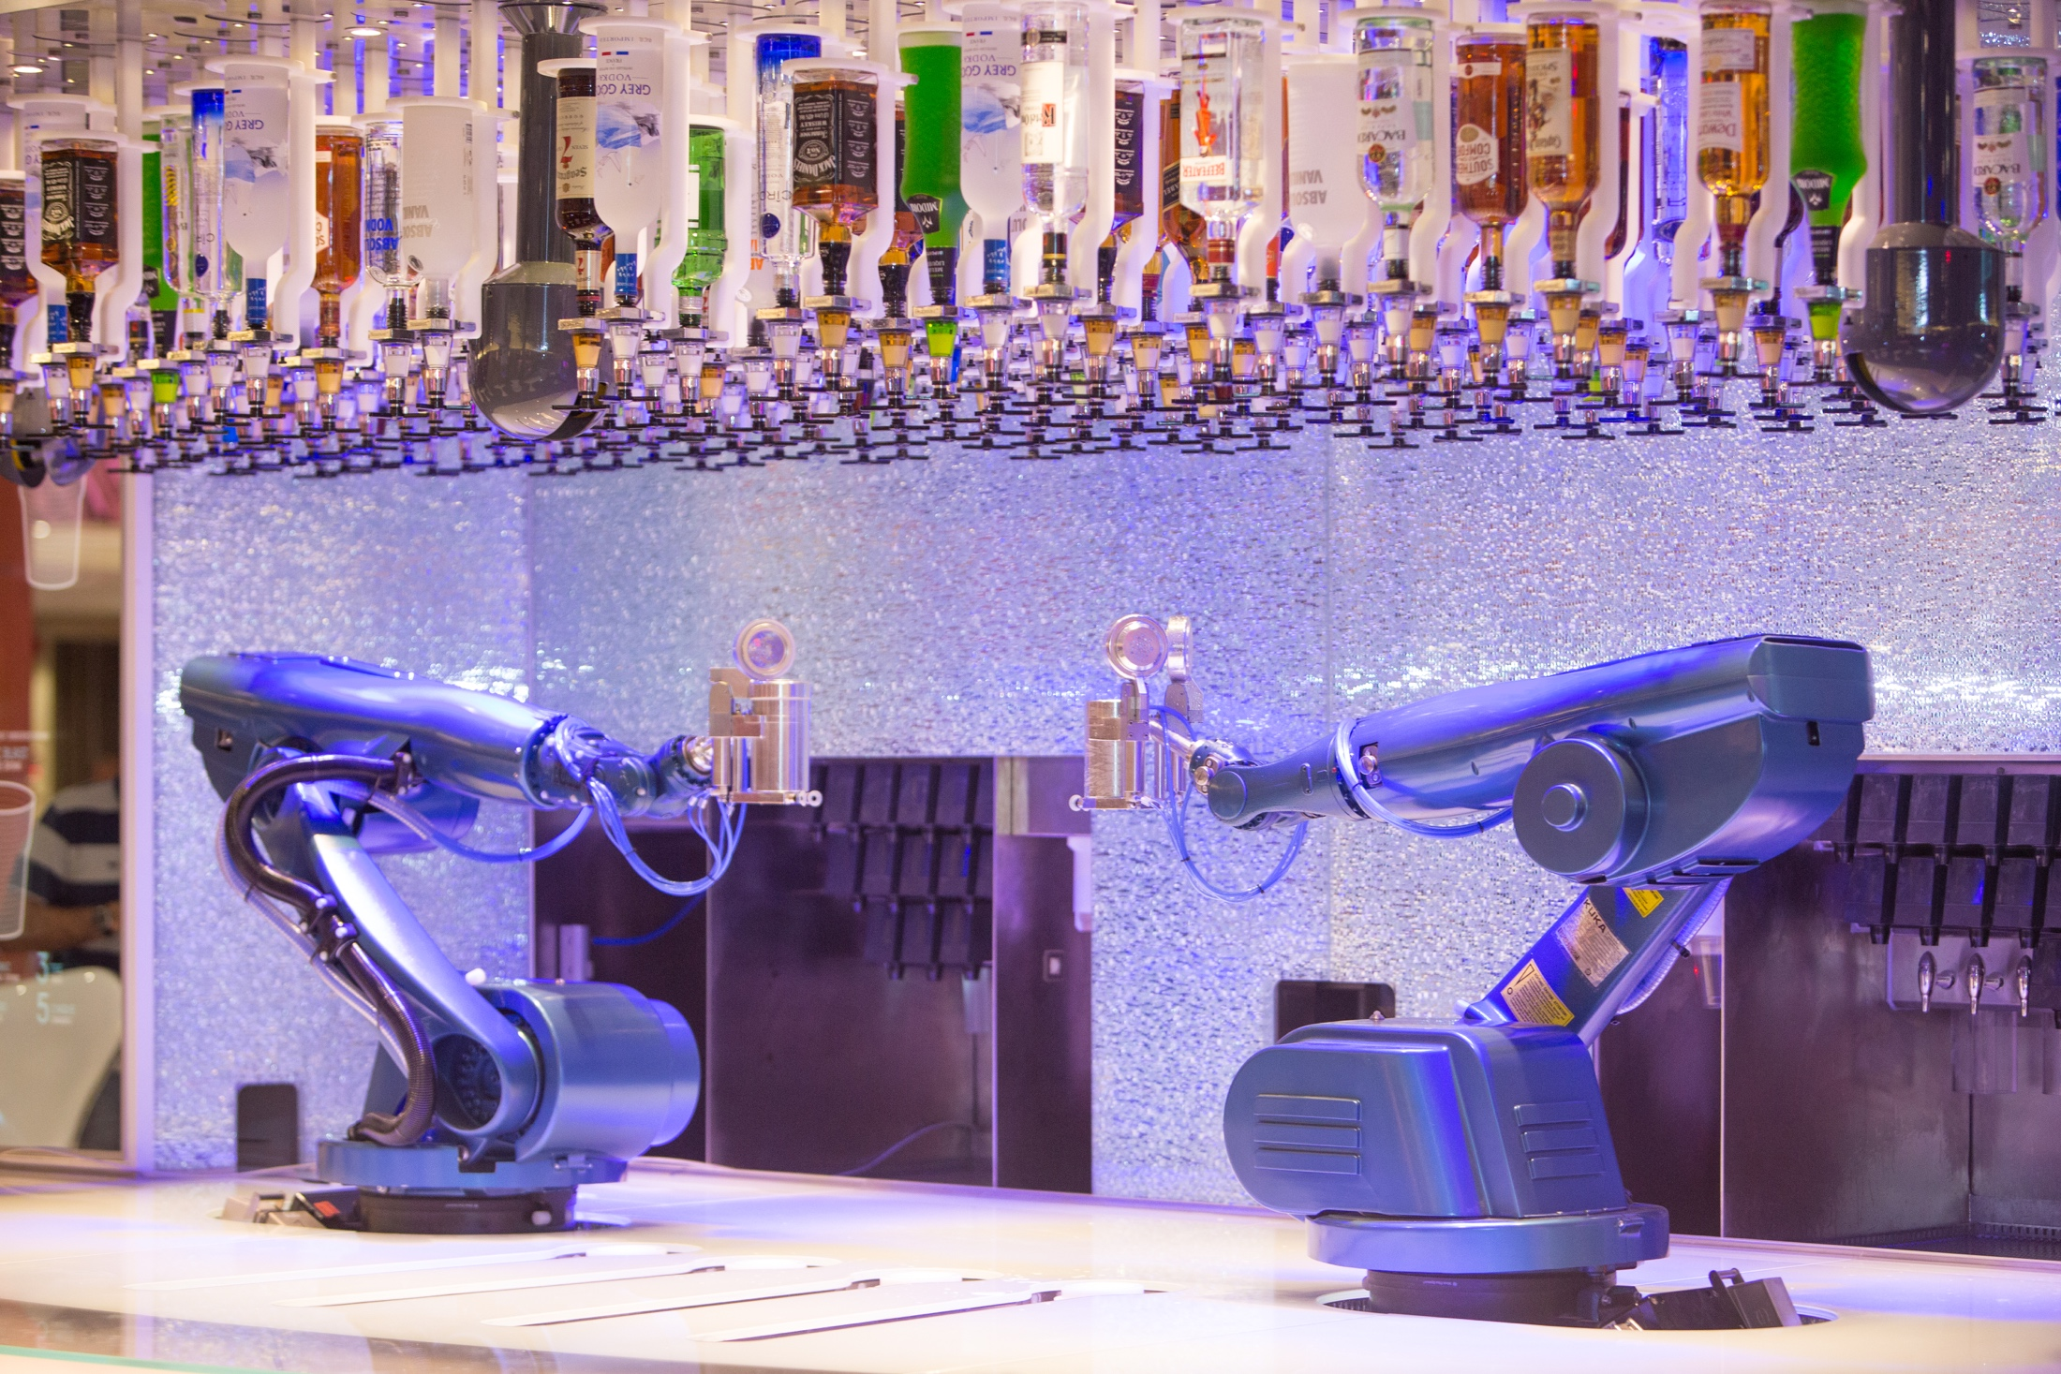
Snapshot: Cruise industry responding to changing consumer tastes
Cruise companies continue to innovate in order to respond to changing consumer tastes
Innovations include go-kart tracks with hovercraft bumper cars, open-air laser-tag courses, Oculus virtual-reality experiences. ‘pedal-powered aerial attractions and zip-lines at sea
Also they are not afraid to introduce new technologies – e.g. Royal Caribbean’s Bionic Bar
Other cruises are offering more themed entertainment to appeal to specific segments of the market.
Finally, cruise companies are becoming more creative with the destinations they chose to sail to.

Slide 12
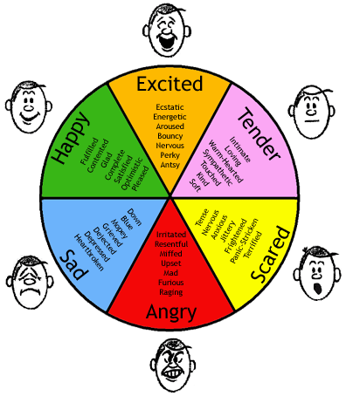
Importance of emotions
Provides opportunity for differentiation
Consumers often highly emotional and intuitive in behaviors
Service employees have a key influence on customers’ emotions
Consumption emotions have an impact on behavioral intentions such as word of mouth
Emotions will also influence customer loyalty as the brand-infused causal loyalty model shows

Slide 13
Brand-infused causal loyalty model

Slide 14
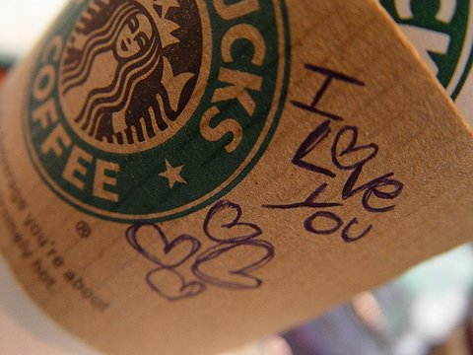
Rational versus emotional motivations
Crosby and Johnson (2007) found that the impact of emotional motivation on loyalty outweighed rational motivation by a ratio of about 5 to 3.
Emotional motivation also had a very strong influence on loyalty in business-to-business (B2B) markets
Findings suggest that building emotional bonds with customers is very important

Slide 15
Impact of rational and emotional motivation across regions

Slide 16
Impact of rational and emotional motivation on B2C and B2B

Slide 17
Lovemarks
Roberts (2004) suggest that to connect emotionally with consumers, brands need to evolve into ‘Lovemarks’

Slide 18
Understanding cross-cultural differences
Human culture is generally defined as the meaning and information system shared by a group and transmitted across generations
Many psychologists (like Hofstede and Triandis) have sought to understand cultural variability
Markus & Kitayama for example suggest that Americans and Western Europeans are more independent than Asians, Africans and Southern Europeans who are more interdependent
In the tourism & hospitality sector, studies show that:
  Asians differ from Europeans and North Americans in their attitudes towards airlines
  Americans are more satisfied than Asians if employees display ingratiation techniques
  Africans are less likely than British customers to complain and switch services
  French have highest satisfaction scores in Europe.

Slide 20
Global trends in consumer behavior
Experiences
  Services as stage, goods as props, to create memorable event
Ethical Products
  Responsible tourism as a significant trend
Health-Consciousness
  Influence of the baby boomers
Customization
  Personalized vacations
Convenience and Speed
Service Quality
  Differentiate services, products and build competitive advantage

Slide 21
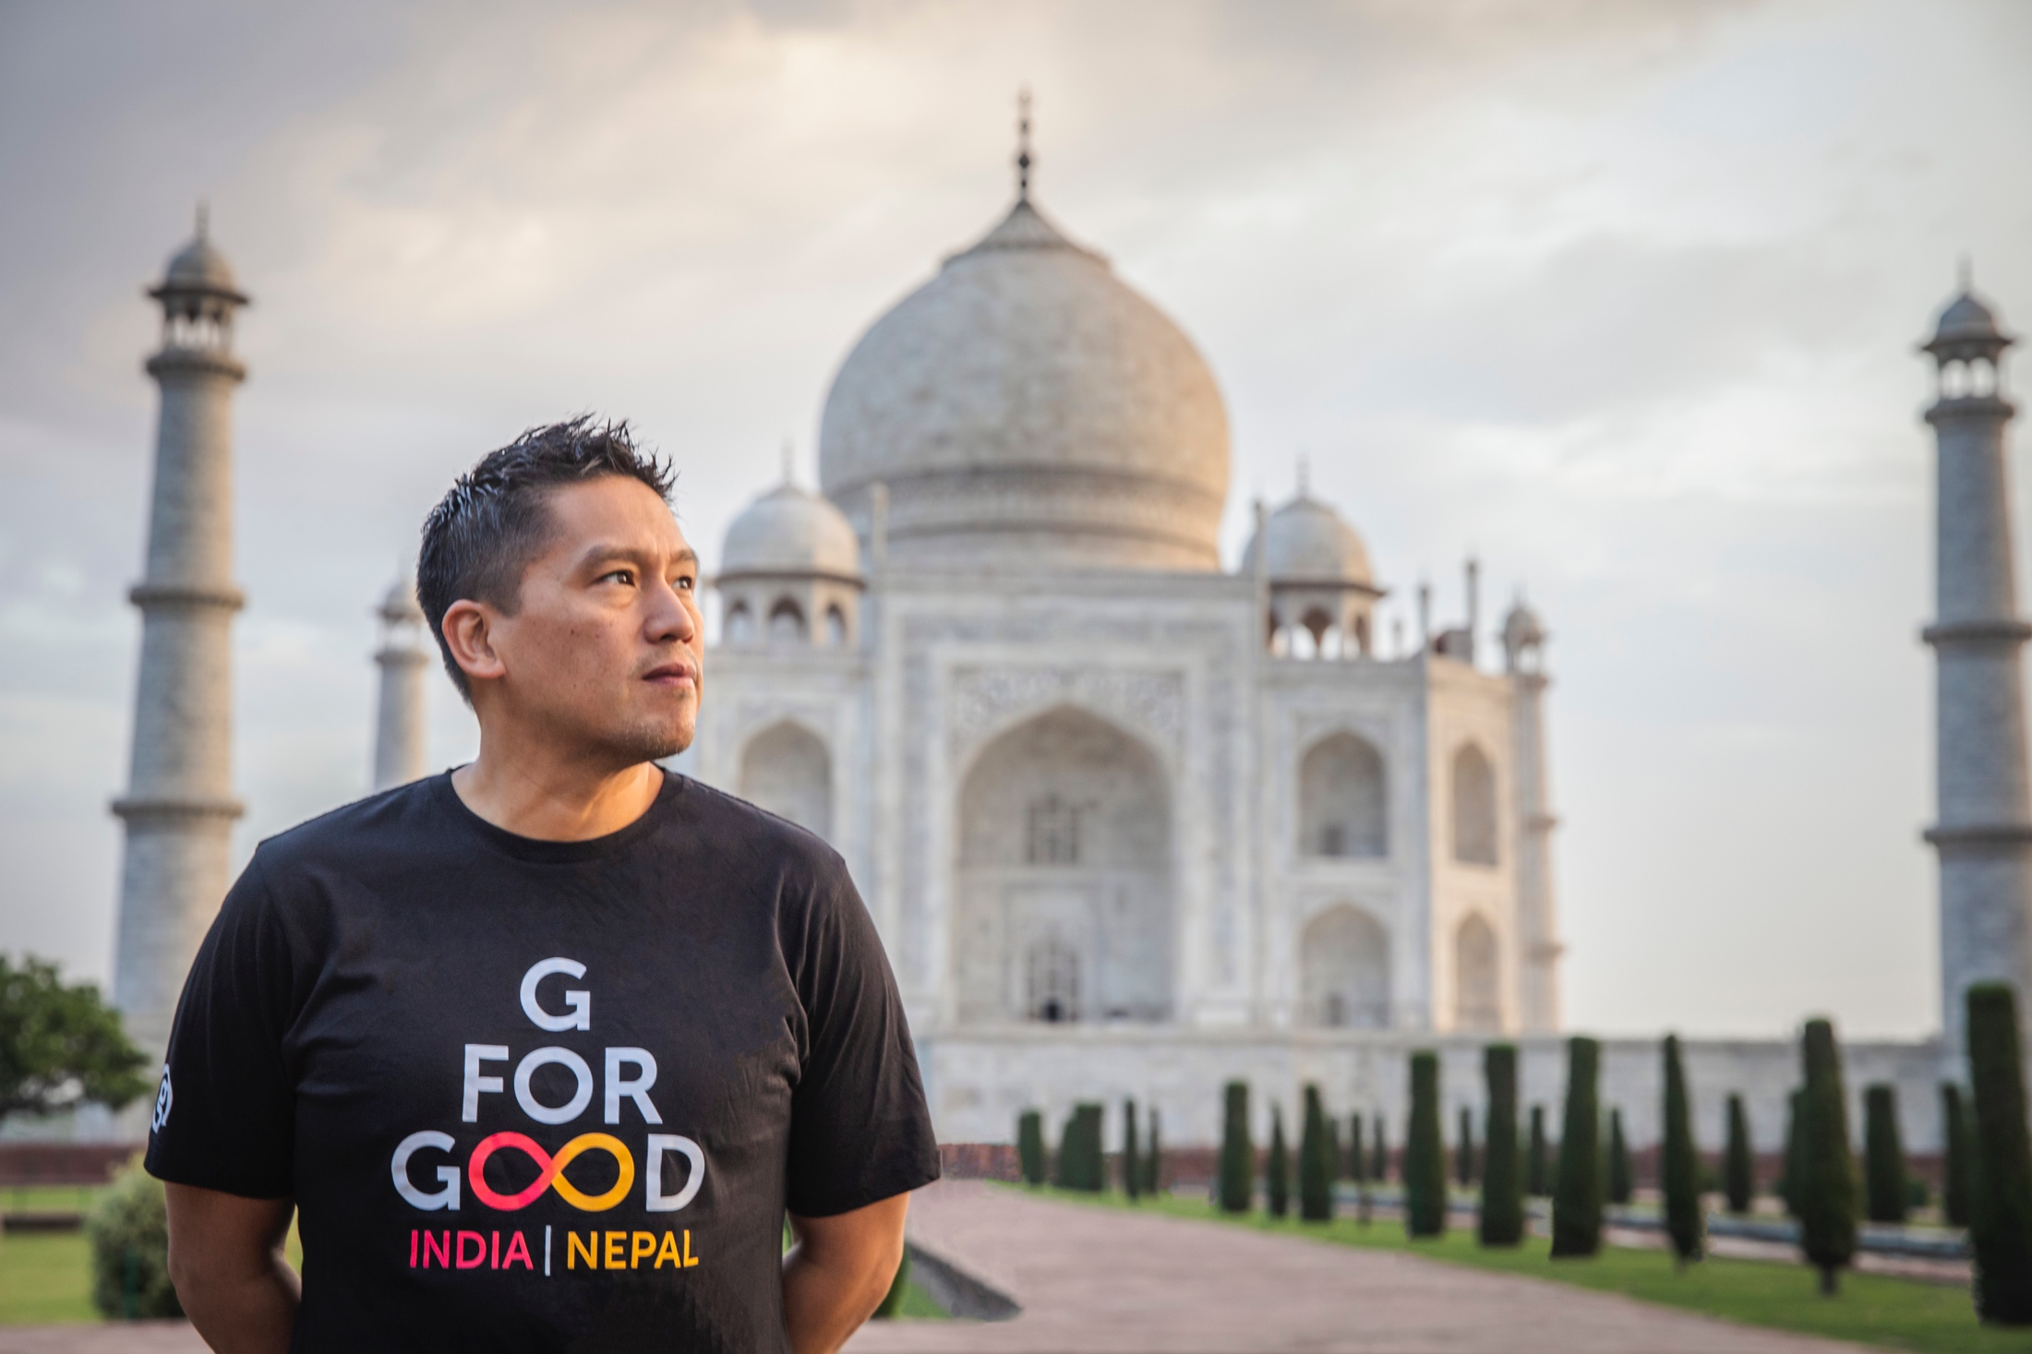
Case Study:
Bruce Poon Tip, G Adventures
‘‘I launched G Adventures with the belief that other travelers would share my desire to experience authentic adventures in a responsible and sustainable manner.’
Understanding the consumer has been Poon Tip’s speciality
The company supports locally-owned businesses and incorporates community-based ecotourism projects into the majority of tours
Recognized the spirit of adventure among all ages and demographics
During the pandemic, Poon Tip published Unlearn pointing to mounting criticism of the travel industry pre-crisis over issues like overtourism

